Slide 1

Chapter 6
Network Layer:
Logical Addressing
6.<number>
Copyright © The McGraw-Hill Companies, Inc. Permission required for reproduction or display.

Slide 2
6-1 IPv4 ADDRESSES
An IPv4 address is a 32-bit address that uniquely and universally defines the connection of a device (for example, a computer or a router) to the Internet.
6.<number>

Slide 3

IP Addressing
Layer 3
32 bits
Logical Address
Assigned by software or administrator
Used by Routers or PC
IP Address Components Fields

Slide 4

Address Space
An address space is the total number of addresses used by the protocol.
IPv4 uses 32-bit addresses, which means that the address space is
or 4,294,967,296
6.<number>

Slide 5

Note
The address space of IPv4 is
2³² or 4,294,967,296.
6.<number>

Slide 6
Notations
There are two prevalent notations to show an IPv4 address:
  Binary notation
  Dotted decimal notation.
6.<number>

Slide 7

Figure 19.1 Dotted-decimal notation and binary notation for an IPv4 address
6.<number>

Slide 8
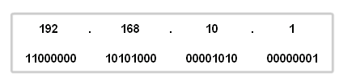
1 1 0 1 0 1 0 1
128+64+16+4+1 = 213
128 64 32 16 8 4 2 1

Slide 9


Example 9.1
Change the following IPv4 addresses from dotted-decimal notation to binary notation.
Solution
We replace each decimal number with its binary equivalent.
6.<number>

Slide 10
In classful addressing, the address space is divided into five classes: A, B, C, D, and E.
Each class occupies some part of the address space.
Note
In classful addressing, the address space is divided into five classes:
A, B, C, D, and E.
6.<number>

Slide 11

Figure 19.2 Finding the classes in binary and dotted-decimal notation
6.<number>

Slide 12

Table 19.1 Number of blocks and block size in classful IPv4 addressing
6.<number>

Slide 13
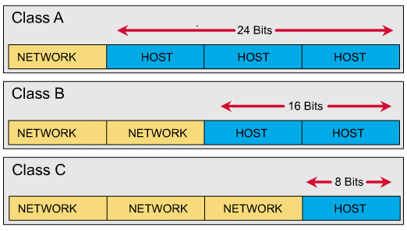
Default Subnet Mask
255 . 0 . 0 . 0
255 . 255 . 0 . 0
255 . 255 . 255 .0

Slide 14
Subnetting
If an organization was granted a large block in class A or B, it could divide the addresses into several contiguous groups and assign each group to smaller networks (called subnets)
Subnetting increases the number of 1s in the mask
6.<number>

Slide 15
Mask
Networks
IP
128
2
128-2=126
192
4
64-2=62
224
8
32-2=30
240
16
16-2=14
248
32
8-2=6
252
64
4-2=2

